Slide 1

Communication & Sales Seminar A
Based on the works of
L. Ron Hubbard
Section V: Application!

Slide 2
AIR
Space

Slide 3
AIR
Space
LIQUID

Slide 4
AIR
LIQUID
Solid

Slide 5
MEST & The Tone Scale
By L. Ron Hubbard
“And he begins to become matter and act like matter, that is, just to the ratio that he goes down the Tone Scale.”

Slide 6
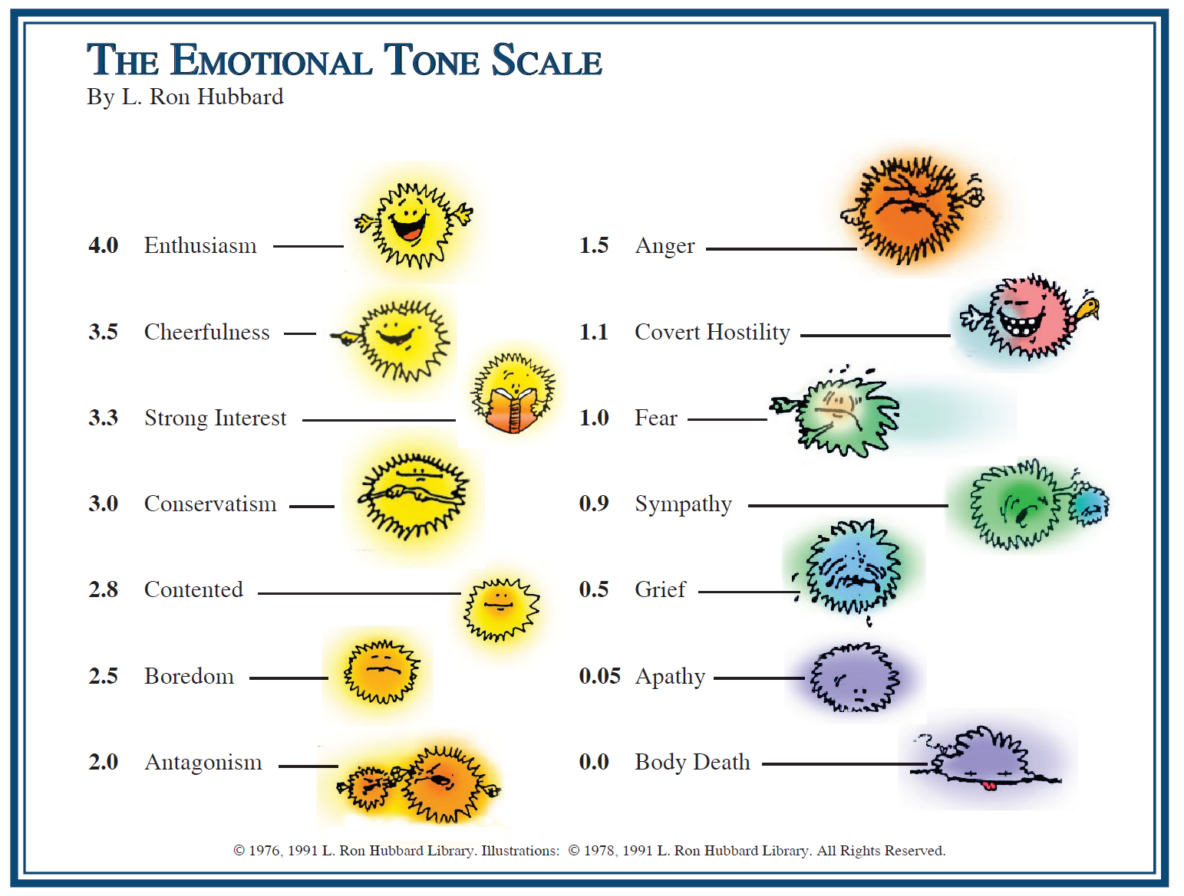
As you go down the Tone Scale you lose SPACE
Notes:
Point out that as you go down the Tone Scale you lose ARC. Give examples such as the 2.0 has less R/Agreement than the enthusiast.

Slide 7
C
22 Games
4.0 Enthusiasm
3.0 Conservatism
2.0 Antagonism
1.0 Fear
R
A
MEST

Slide 8

Agree
Want
Inflow
Outflow
Don’t Want
Disagree

Slide 9
Hard Sell
By L. Ron Hubbard
“Hard Sell: Caring about the person, not being reasonable with stops and barriers and getting him fully paid up and taking the service.”

Slide 10

Is Hard Sell an Inflow or an Outflow?
Soft Sell
Inflow
Outflow
Hard Sell

Slide 11
The Sales Line

Slide 12
The Sales Line
Receptionist

Slide 13
The Sales Line
Receptionist
Appt. Secy.

Slide 14
The Sales Line
Receptionist
Appt. Secy.
Dr./Diagnosis

Slide 15
The Sales Line
Receptionist
Appt. Secy.
Dr./Diagnosis
Sales Person

Slide 16
The Sales Line
Receptionist
Appt. Secy.
Dr./Diagnosis
Fin. Secy.
Sales Person

Slide 17
The Sales Line
Receptionist
Appt. Secy.
Dr./Diagnosis
Appt. Secy.
Fin. Secy.
Sales Person

Slide 18
The Sales Line
Receptionist
Appt. Secy.
Dr./Diagnosis
Dr./Treatment
Appt. Secy.
Fin. Secy.
Sales Person

Slide 24
Trouble

Slide 25
What Stops Your Hard Sell?
Your own overts,
Becoming PTS,
Getting Serious!

Slide 26
Addressing Common Objections!
“I don’t have any money.” (also, too expensive, can’t afford it, etc.)
“I only want to do what my insurance covers.”
“I need to check with my spouse first.”
“I need to think about it.”
“I’m really busy right now. I don’t have time. I need to wait.”

Slide 27
`
THE END!
©2020 MGE Inc. All Rights Reserved. Grateful acknowledgement is made to L. Ron Hubbard Library for permission to reproduce selections from the copyrighted works of L. Ron Hubbard. HUBBARD is a trademark used pursuant to a license agreement. Printed in the USA. IA #0605203

